Slide 1
Schedule of Charges
Contact Persons:
Michelle Parker (2-3807)
Julie Huff (2-1853)
Division of Financial Services (DFS)
Financial Reporting

Slide 2
Objectives
Define Schedule of Charges
Determine when one is needed
Determine allowable costs
Correctly complete required forms
Identify ongoing responsibilities

Slide 3
Policy on Sales of Products and Services
A sale is deemed appropriate only if it is an integral part of, or reasonably related to, an activity which is essential to the fulfillment of the institution’s instructional, research or public service missions.

Slide 4
Why do you need a Schedule of Charges?
To ensure that everyone is being charged the same rate and that the Federal Government is receiving the lowest rate.

Slide 5
When is a Schedule of Charges needed?
Anytime a department is selling a service, product, or by-product to internal or external customers.

Slide 6
Internal Customer
KSU Department and other State Agencies who use state appropriations to pay for the product or service. Grants and contracts processed through Preaward Services are considered internal funds and should be charged the internal customer rate.

Slide 7
External Customer
External customers include, but are not limited to, students, members of the faculty or staff acting in a personal capacity and members of the community. It also includes other State agencies who use non-state appropriations to pay for the product or service.

Slide 8
Service Clearing Unit
An operating unit set up to provide services exclusively to University departments which has additionally been specifically designated by the legislature as a service clearing unit. (ie. Printing Services, Facilities Car Pool) See PPM 6085.030 for a complete list.

Slide 9
Breakeven Concept
Rates are generally calculated based on budgeted projections of operating expenses and projected volume of the services or products to be provided during the fiscal year. The goal is to calculate a rate that will ensure revenues reasonably offset expenses with no significant profit or loss.

Slide 10
By-Product
In the course of fulfilling the University’s mission, products and services may result that can be sold to the University community or the general public. These by-products should be priced using the market rate, in order to avoid unfair competition with an external provider.

Slide 11
Examples
Services
Programming
Slide Scanning
Client Consultation
Standard Tests or Analyses
Products
Color Prints
Recordable CD
Film
By-Products
Hearing Tests
Aircraft Maintenance
Meat
Flour
Dairy

Slide 12
Resources
Website http://www.k-state.edu/finsvcs/fri/
Schedule of Charges Tools reference document
PPM Chapters 6080 and 6085
E-forms blank forms and example forms

Slide 13
Submitting a Schedule of Charges
Schedule of Charges
Schedule of Charges Justification
Supporting documentation including:
Rate Calculations
Price lists
Advertising materials
Brochures
Price Comparisons
Any other relevant items

Slide 14
Schedule of Charges Form
Number each item consecutively
Include units of measure
Note certification statements

Slide 15
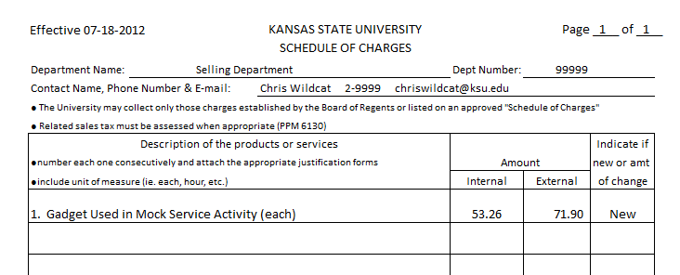
Note unit of measure
Enter amounts here from Justification Form(s)
If the amount of an established rate is changing, amount of change should be preceded by either
↑ or ↓

Slide 16
Certification Statements

Slide 17
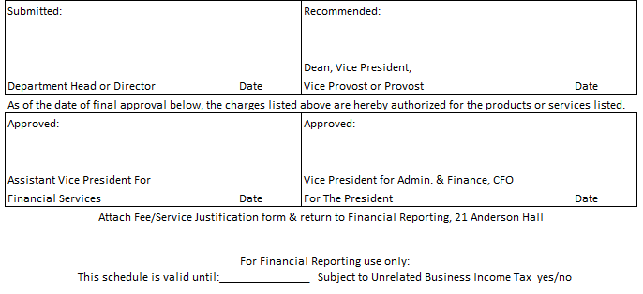
Both blocks should be signed before sending to Financial
Reporting
If activity continues past this date, a new SOC needs submitted
If yes, see UBIT information

Slide 18
Justification Form
Justification for Charges
University mission
Method of selling
Customer Base
Project # for Revenues AND Expenses
Direct Costs
Non-state funded salaries, wages and benefits
Supplies
Materials
Other contractual services
May include equipment depreciation
Indirect Cost Calculation

Slide 19
Customer % Should total 100%
All Revenue & Expenses should be in the same FIS account

Slide 20
Salaries, Wages, Benefits
12 Month Employee = 2,080 Hours/Year
9 Month Employee = 1,600 Hours/Year
Benefit Rates: http://www.k-state.edu/research/preaward/fringe.htm
Verify salary rate via HRIS

Slide 22
Supplies, Materials & Miscellaneous
Include details for any calculations
Example: 1 Gear at $5.00 each
Provide calculations in description area if needed

Slide 24
Maintenance &/or Software Lease Agreements
Include details for any calculations
Determine amount applicable to SOC being calculated

Slide 25
Include SOC and
Non-SOC activity

Slide 26
Depreciation Expense
The equipment items are identified separately from non-service center equipment.
The equipment exists and is usable, used and needed.
The equipment has not outlived the depreciable life (fully depreciated).
The equipment was not purchased with federal funds.
Sales will NOT be made primarily to grant or contract accounts.

Slide 27
Annual Depreciation Expense
Equipment is defined as items $5,000 or more with a useful life > 1 year.
Established using the straight-line basis, assuming no salvage value. See Tools document for Useful Life.
The projected cost of replacement cannot be included when developing depreciation schedules.
Use FIS Discoverer Report “ZFA Fixed Assets” for Property Number, Purchase date, Object Code, Acquisition code.

Slide 29
Expenses must be charged to the same FIS Account that the revenues are deposited to.

Slide 30
Sales to Internal Customers
KSU Grants are considered internal customers
Rates charged to customers need to equal the amount(s) calculated and approved on the Schedule of Charges.
Invoices and payment documents should include enough detail to verify the amounts being charged and paid reflect the approved Schedule of Charges.

Slide 31
Indirect Costs
Also known as F&A (Facilities & Administration) cost rate.
Determine amount applicable to SOC being calculated.
Required for sales to external customers
The indirect cost rate is based on the university’s federally negotiated F&A cost rate. The research rate is 50% and the public service rate is 35%.

Slide 32
Sales to External Customers
For the purpose of charging for goods and/or services, students and University employees acting in a personal capacity are considered external users.
The rate is equal to the base rate (internal rate) plus applicable F&A costs.
Rates charged to customers need to equal the amount(s) calculated and approved on the Schedule of Charges.

Slide 34
Depositing indirect cost receipts
Deposit to the same department account and object code as the direct portion of the fee.

Slide 35
Unrelated Business Income Tax

Slide 36
Unrelated Business Income Tax (UBIT)
Revenue generating activities not directly related to KSU’s exempt purposes of research, instruction and public service may be subject to UBIT.
UBIT determinations are very dependent on the facts and circumstances of each activity.

Slide 37
Unrelated Business Income Tax (UBIT)
If an activity is deemed to be subject to UBIT, the department will be notified.
The department will need to provide DFS with revenue and expense information on an annual basis for completion of the University’s UBIT IRS tax return.
The department will also need to provide a FIS account that can be charged if it is determined UBIT taxes are owed to the IRS.

Slide 38
Checklist
Have you followed the Board of Regents’ Policy of Sales of Products and Services?
Is the product or service an integral part of the University’s mission?
Is the Federal Government receiving the lowest price?

Slide 39
Checklist
Do you have procedures in place to ensure a breakeven pricing schedule?
Have you ensured that state funds will not be needed to subsidize this activity?

Slide 40
Ongoing Responsibility
Revise the Schedule of Charges whenever there is a new fee, a change in a fee or the fee becomes outdated.
Notify Financial Reporting when a fee is no longer needed.
Review operations annually and verify that it is a break-even operation. Revise rates if needed.

